Slide 1
Group 5 - Petit Website Project
Sprint Cycle 3

Slide 2
Team members
1.Brian Le (Bao Le) - Frontend Developer
Learning and Implementing code in React js. Updated for homepage, about page. Created employee page
3.G (Guillermo Clara) - Full-Stack Developer
Implemented an authentication system using Json
Web Tokens. Set up endpoints to provide data to authenticated users only. Modified React pages to enable communication with backend through fetch API
5.Jisoo Park - Backend Developer
- Login and Signup GET and POST request endpoints / configuration
- Database Reconfiguration / Table Modification
- Tested email authentication.
- Presentation Document Management
2.Aleeza Iftikhar- Frontend Developer
Appointment maker page. Created a dashboard page for business owners. Implemented services editing page
4. Jennie Vu (Nga Vu) - Frontend Developer
- Research and tested multiple calendar implementations available for ReactJs. Chose DayPilot as the third party component for schedule selection and edit for its flexibility and simplistic usage
- Implement the DayPilot calendar into the "View Appointment"
- Create mock data to demo to team. Build calendar as a reusable components that can be used anywhere in the project
- Adding container class to specific views, preventing styling overwrite. Update some global styling to make zone specific styles

Slide 3
Project Backlog SC 3
Create a method to create and send a unique link after the user clicks booking the appointment button (Testing required)
Create a post request handler in this page so that when the appointment cancel button is clicked it will change the db.
Finalize Business dashboard and create Settings page
Update pages managing employees and services
Update ‘view appointments’ page in business dashboard to show list of upcoming/previous appointments.
Authentication System (In progress)

Slide 4
Challenges & Lessons Learned
Challenges:
We had to reset all our database to re-configure the tables
Understanding JWT and implementing it in our project
Lessons Learned
Do not hastily change database table columns
Further understanding how to utilize libraries

Slide 5
Project Backlog SC 4
Make the website responsive
Finish implementing authentication that require owner access
Testing email sending method after appointment creation
Improve the CSS of the project by organising the website better
Implementing mechanisms to fetch data from the backend into other pages
Make pop ups to display errors
Password recovery system

Slide 6
https://github.com/Team5SWE/Petit

Slide 7
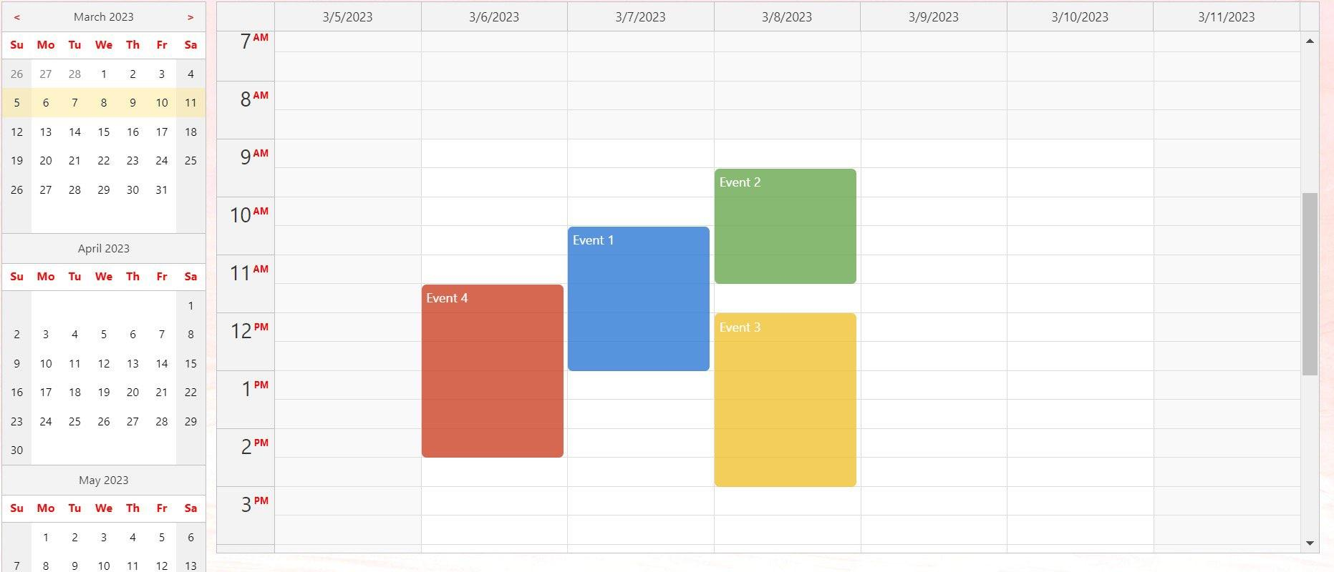
View Appointment

